Slide 1
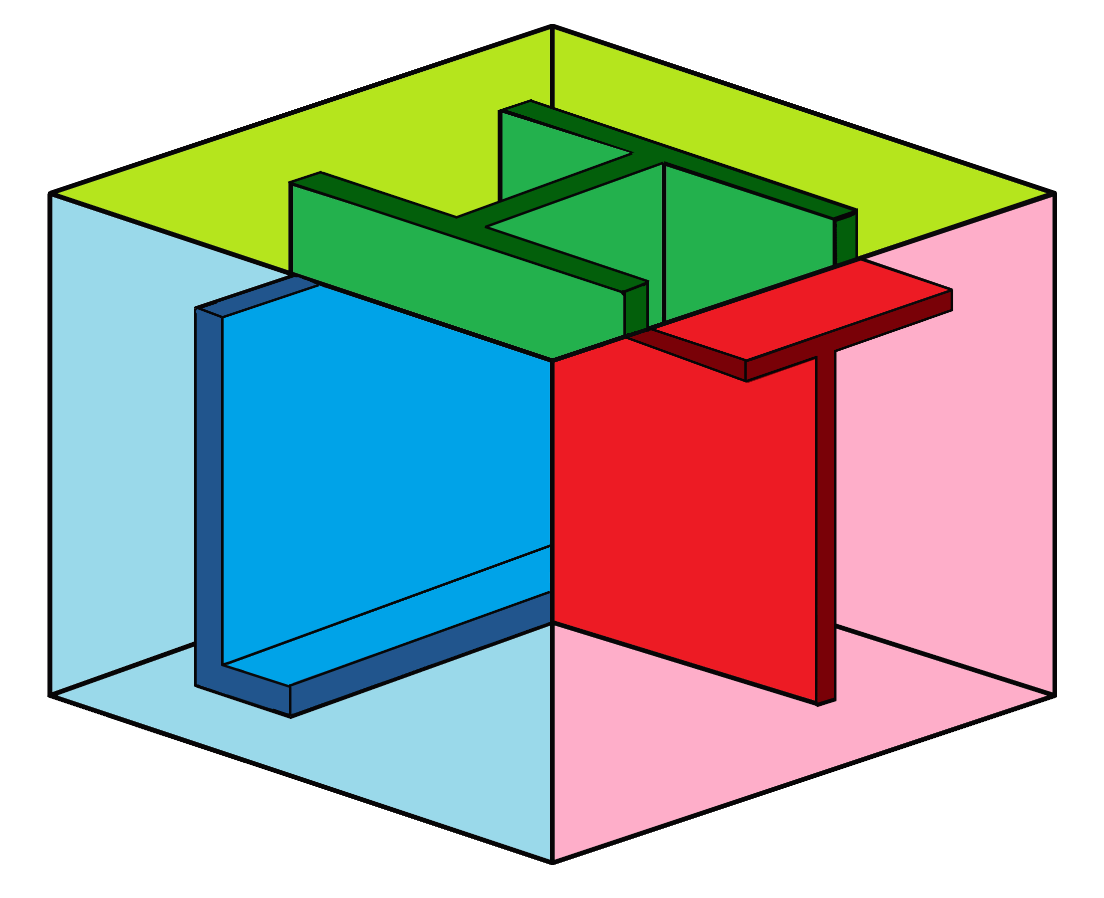
Formalism for the Semantic Web
Challenges and Potentials
ICWR 2018 Keynotes
Tehran, Iran
April 25-26, 2018
Hassan Aït-Kaci
HAK Language Technologies

Slide 2
Formalism for the Semantic Web
Challenges and Potentials
ICWR 2018 Keynotes
Tehran, Iran
April 25-26, 2018
Hassan Aït-Kaci
HAK Language Technologies

Slide 3
Important general points
Many thanks to the ICWR 2018 organizers for the honor of this invitation
The first part of my presentation will discuss challenges and potentials of the
It is meant for a general audience
If enough interest and as time permits, this could be followed by a more detailed technical presentation
Please ask questions; feel free to propose discussions
Semantic Web
3

Slide 4
Wherein Lies the Knowledge?
The next wave of information processing must adapt to a radical change of reality—namely, the enormous quantity of available data and the rate at which it accumulates. Implicit in this data hides a wealth of information—literally!
A recent article in the Wired magazine illustrates this by reporting the noticeable prediction success of a small data analysis company called Recorded Future whose main office is located in Gothenburg, Sweden.
Such is this company's rate of success in predicting world's events and situations before anyone else, that most major world players (including Google and the CIA!) line up as its customers. How they do it is their trade secret, of course—but, put simply, they find all they need in publicly available data.
4

Slide 5
Wherein Lies the Knowledge?
Yet, as blatantly successful as his company may be, Recorded Future's co-founder and CEO Christopher Ahlberg makes the following statement:
Indeed, Recorded Future's boon may only be the tip of an iceberg. So the challenge is: how to extract and use knowledge hidden but implicit in public data. And we're talking about Big Data!
"... to develop a tool that could create predictions for any input, from finance to terrorism, would be much harder. [One] would not only have to index the internet, but also understand and interpret it." —Christopher Ahlberg as quoted by Tom Cheshire in Wired–November 10, 2011
5

Slide 6
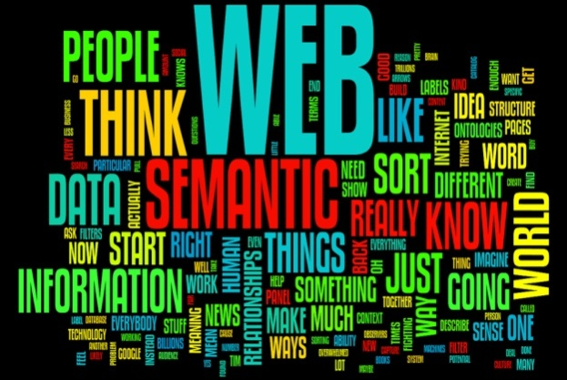
The “Semantic Web”?
It has been now over a decade that the Semantic Web has been heralded as the means to infuse meaning into the World-Wide Web.
Subject of controversy, this ambitious objective has been disputed re. what is actually meant by “meaning.”
Many see this as a truly achievable potential made possible by the sublimation into knowledge of massively interconnected standardized information.
3

Slide 7
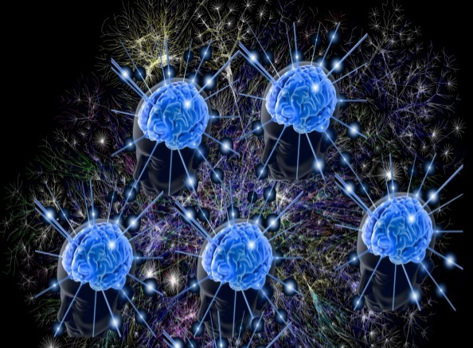
Semantic Web Challenges
Reasoning with interconnected information
Automate its knowledge structuring (standard?)
Automate its reasoning power
Need to agree on (a) standard(s)
4

Slide 8
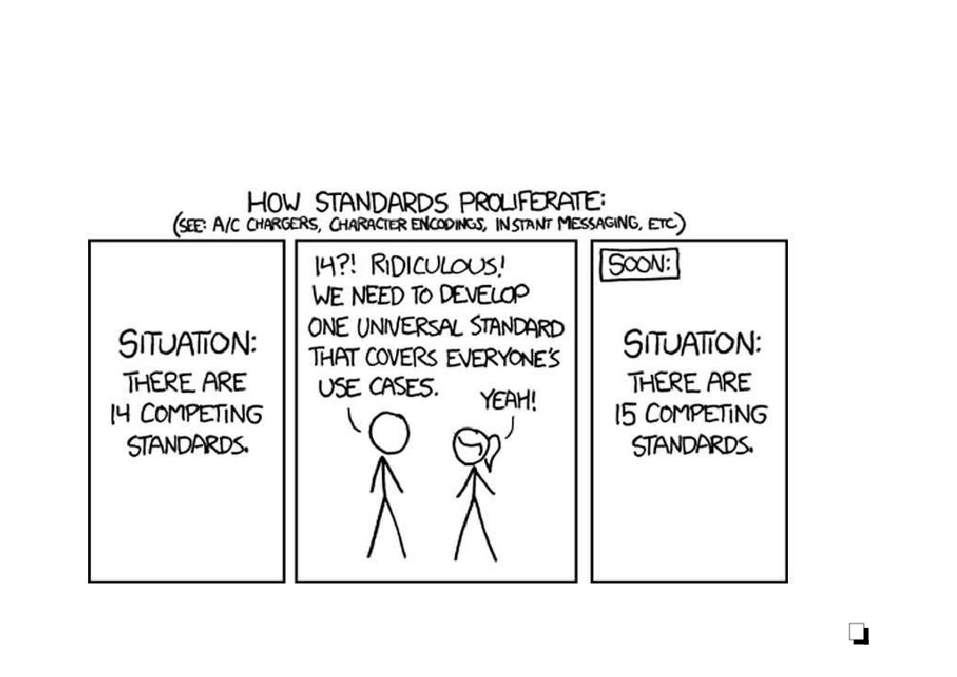
Semantic Web Challenges
Standards galore ... but:
How many are really used? ... beyond trivial use cases.
7

Slide 9
Standards—KIF
In AI, KIF is not a narcotic but it means:
Knowledge Interchange Format
http://www-ksl.stanford.edu/knowledge-sharing/kif/
A LISP-like language and S-expression structure language proposed to describe many (all?) knowledge representation formalisms so they
each provide their own standardized form to one another.
5

Slide 10
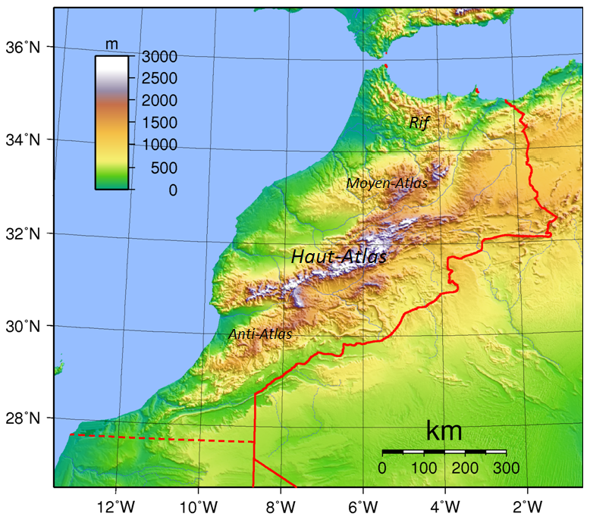
Standards—RIF
In AI, the RIF is not a mountain range in northern Morocco but the:
Rule Interchange Format
http://www.w3.org/standards/techs/rif
An XML standard language (using its own meta-syntax and structure) proposed to describe many (all?) rule formalisms so they each provide their own standardized form to one another.
6

Slide 11
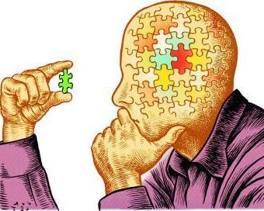
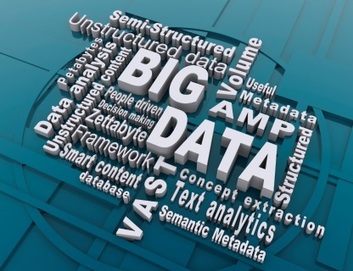
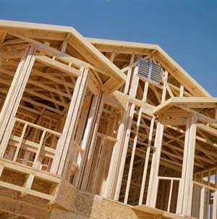
Semantic Web Reasoning Challenges
Scalability
Distribution (incrementality, data diffusion and coherence)
Structural reasoning
Temporal reasoning
Approximate reasoning
Learning—Abductive and inductive reasoning
Big Linked Data = “Blinked” Data?
Knowledge evolution management
...
8

Slide 12
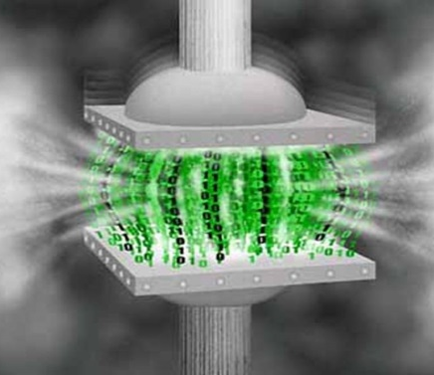
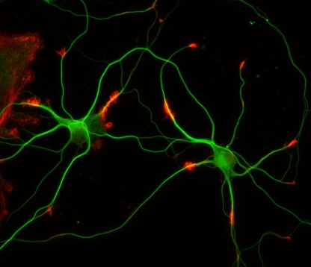
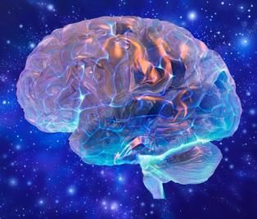
Semantic Web Challenges—Scalability
Scalability
Reasoning in the large
Performance
Tbox reasoning (“ontological” reasoning)
Abox querying (where does the reasoning help?)
Data handling
Big Data (synopsize the essence)
Linked Data (synaptic reasoning)
“Blinked Data?” (huge brain)
9

Slide 13
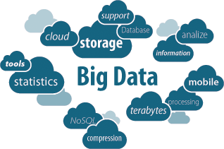
Semantic Web Challenges—Distribution
Distribution (incrementality, data diffusion and coherence) Triplestores in the Cloud
Performance
Tbox reasoning (“ontological data” schema?)
Abox querying (SPARQL vs. NoSQL triple-as-relation)
Data handling
Big Data (Relational/Semi-structured)
Linked Data (RDF Triples)
“Blinked Data?” (interconnected massive triplestores)
10

Slide 14
Semantic Web Challenges—Structural reasoning
Structural reasoning
Efficient knowledge processing
Default tolerance (detail abstraction)
Semantic context
11

Slide 15
Semantic Web Challenges—Temporal reasoning
Temporal reasoning
Event processing
Time-relative logic
Time-sensitive knowledge
12

Slide 16
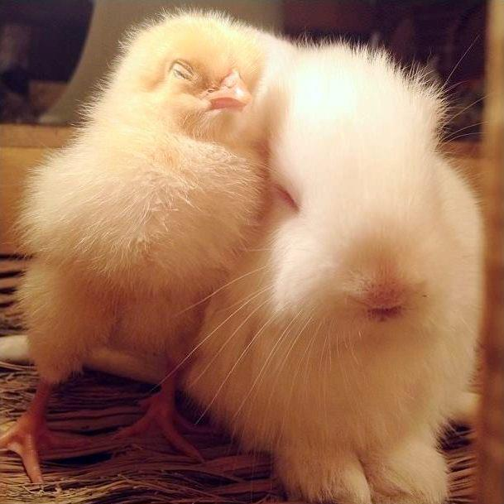
Semantic Web Challenges—Approximate reasoning
Approximate reasoning
Probabilistic logic (Bayesian, Markovian)
Fuzzy set logic
Rough set logic
13

Slide 17
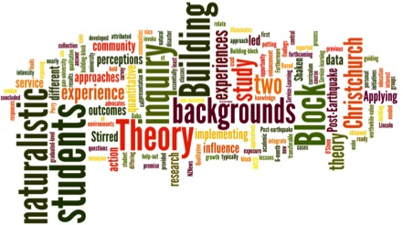
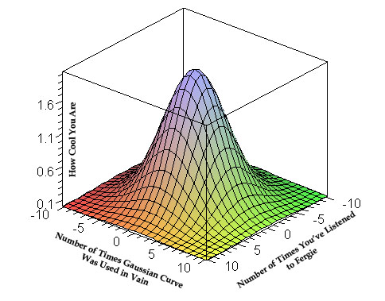
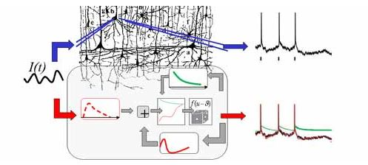
Semantic Web Challenges—Learning
Learning—Abductive and inductive reasoning
Structural learning
Statistical learning
Combinations
14

Slide 18
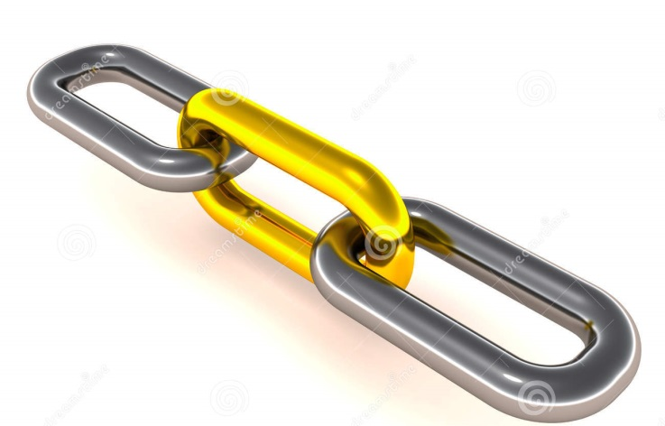
Semantic Web Challenges—Linked Data
Linked data
interconnection management
“Blinked Data”
Combinations
15

Slide 19
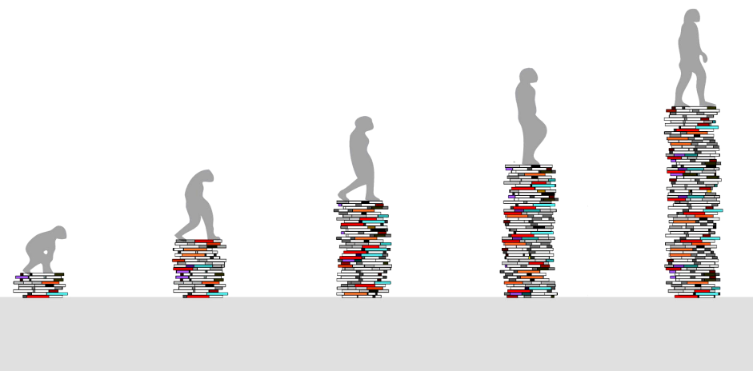
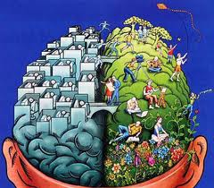
Semantic Web Challenges—Knowledge evolution
Knowledge evolution management
Coherence maintenance
Provenance and trustability
Context management
16

Slide 20
Semantic Web = World-Wide Brain?
The essential argument is that it is expected that standardized knowledge can somehow arise and be used in the form of ontologies from massively interconnected information.
Such is the potential for Linked Data, for example.
Even if such a hope could be achieved, yet another challenge for such knowledge, however it may be represented, is to be effectively, let alone efficiently, processed to provide intelligence.
The key is that, whatever the standards may be, one cannot escape the need for formal encoding of such knowledge to lend itself to inference of implicit networked knowledge, beyond the classical processing of explicit silo-ed data.
21

Slide 21
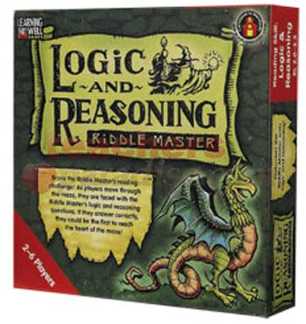
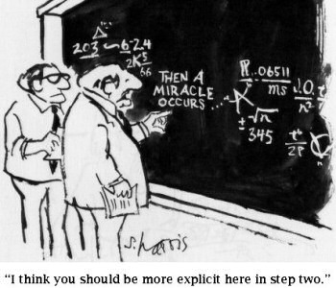
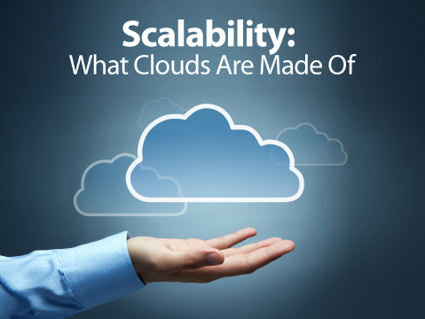
6th Generation Computing?
Hence, this all smells, tastes, and looks again like a “been there, done that!”; viz., the promises of the 5th Generation Project of the 80’s.
In fact, the SW’s objective is much more challenging today taking into account the exponential explosion of data and the inescapable need for scalable processing.
In addition, cloud networking and the ubiquitous distribution of information has made this task even more daunting.
22

Slide 22
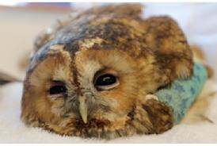
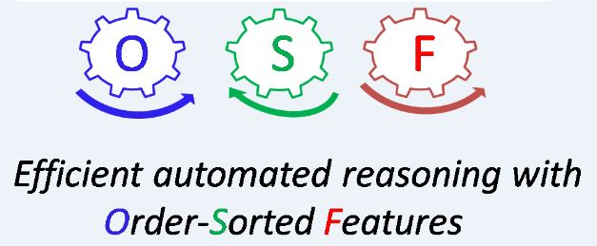
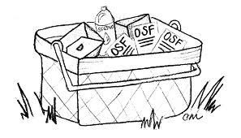
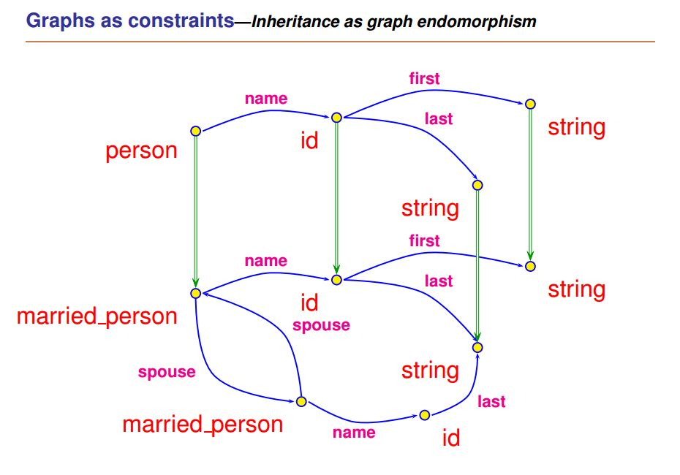
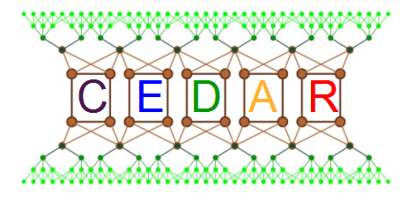
CEDAR—Constraint Event-Driven Automated Reasoning
Is there a remedy?
Owls break easily!
ANR funded chair of excellence – Jan. 2013 Jan. 2015
18

Slide 23
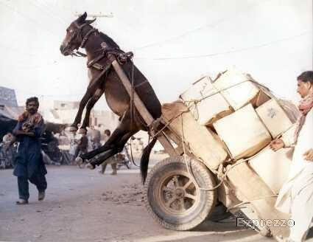
CEDAR—Scalability and Distribution
The CEDAR project addresses mainly two concerns:
Scalability of ontological reasoning
Management and access of
distributed ontological knowledge
and “Blinked Data”
19

Slide 24
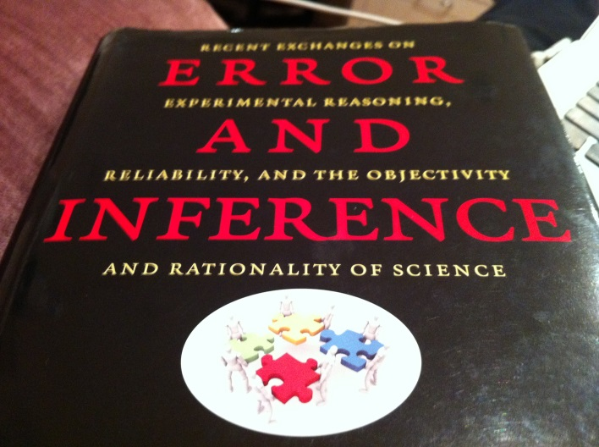
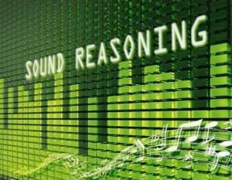
CEDAR—Scalability and Distribution
The CEDAR project’s approach:
experiment with existing systems vs. our own
reasoning technology
experiment with Hadoop-style architecture for
concurrent processing of distributed knowledge
and “Blinked Data”
20

Slide 25
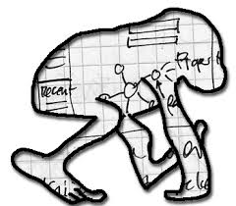
Semantic Web—Where are we today?
If one must be critical:
W3C SW standards have not really been tested
Viable alternatives have not really been considered
However, all SW formalisms must imperatively take into account the formidable challenges described above.
Namely:
any knowledge representation and efficient inference based on it must be scalable, incremental, capable of dealing with approximate data (fuzzy, probabilistic, incomplete) in real time, and manage information of enormous size and diversity distributed all over the Internet.
23

Slide 26
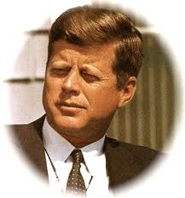
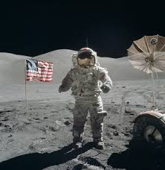
Semantic Web—Where we may be tomorrow?
So how may we expect the Semantic Web to turn into a reality?
We have surveyed a few challenges and potentials
faced by the W3C to make the Semantic Web a
reality.
Such a large effort is bound to produce unforeseen
serendipitous offshoots in the same manner as the
“MoonTechnology” of the 60’s did pursuing JFK’s
otherworldly dream of human moon settling.
In order to do so, we must adapt to unexpected
reshaping of the (computing) world, taking every
opportunity to make what is possible become real.
24

Slide 27
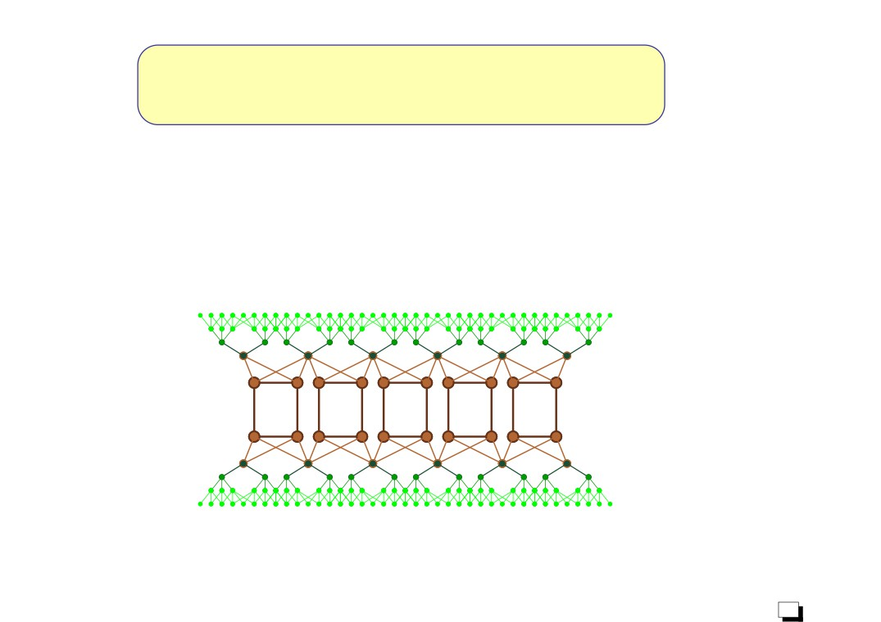
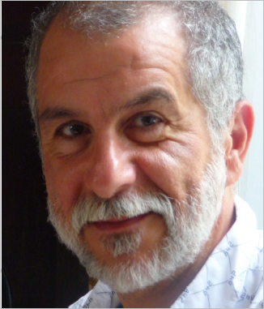
Thank You For Your Attention !
Hassan Aït-Kaci
hak@acm.org
25

